Slide 1
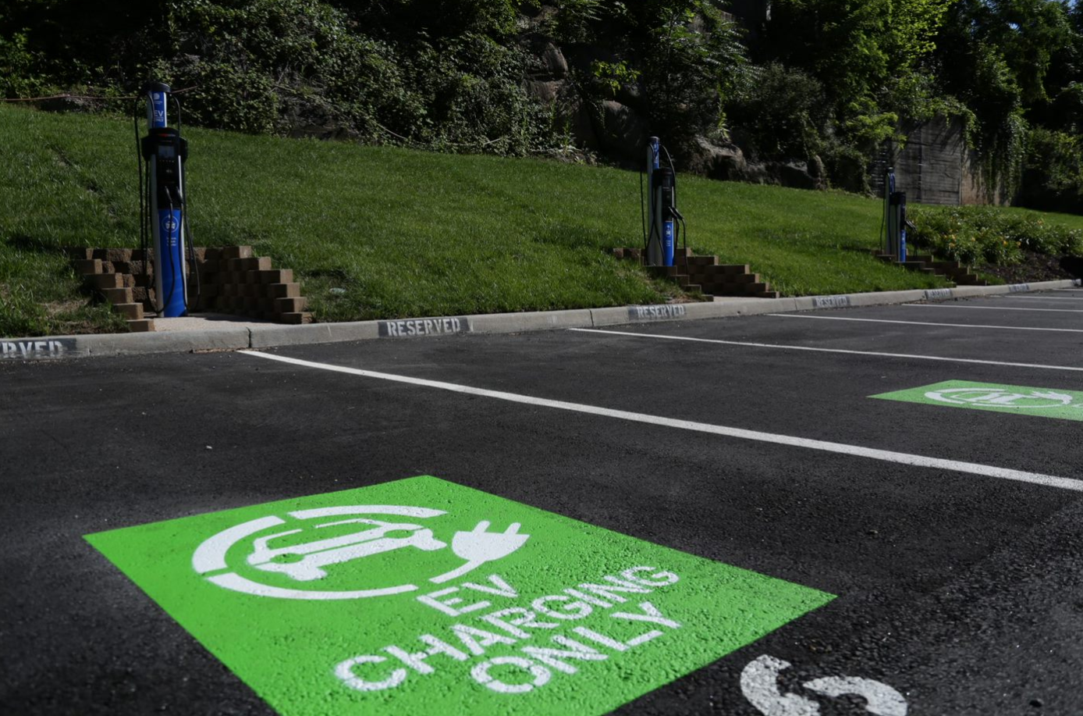
Transportation Electrification
Lisa Moerner
Director, Innovation & Sustainability Technology

Slide 2
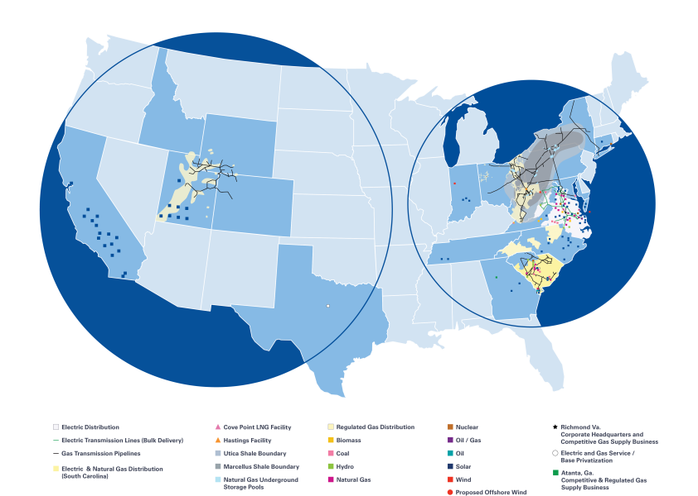
Dominion Energy: Powering America’s Energy Needs
19,000 employees across 18 states
Regional energy hubs in the Mid-Atlantic, Southeast and Rockies
Nearly 7.5 million electric and gas customers
31,000 gigawatts of electric generation (11,000 zero-carbon)
95,000 miles of electric distribution & transmission lines
108,000 miles of natural gas distribution & transmission pipelines
2nd largest natural gas storage operator in the U.S.

Slide 3
Changes in Generation Fuel Mix – Dominion Energy 2007 vs. 2018

Slide 4
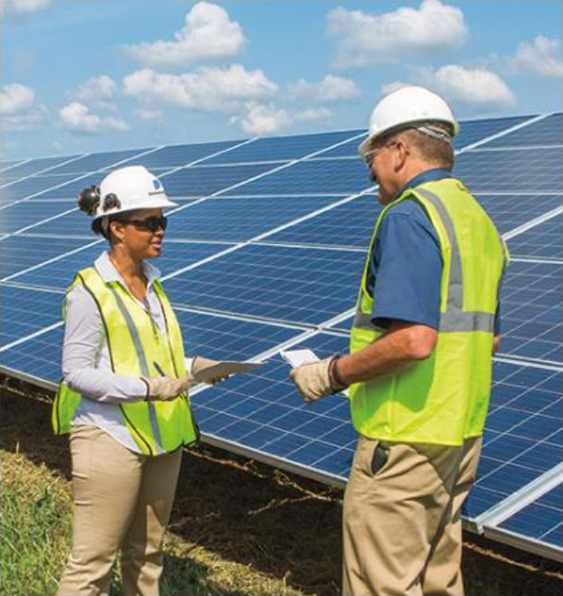
Dominion Energy’s Carbon and Renewable Commitments
By 2022:
3,000 megawatts of solar and wind energy under development or in operation
By 2030:
60% reduction in carbon intensity (vs. 2000 levels)
55% reduction in carbon emissions (vs. 2005 levels)
By 2050:
80% reduction in carbon emissions (vs. 2005 levels)

Slide 5
Projected EV Adoption Growth in Virginia
Source: Navigant

Slide 6
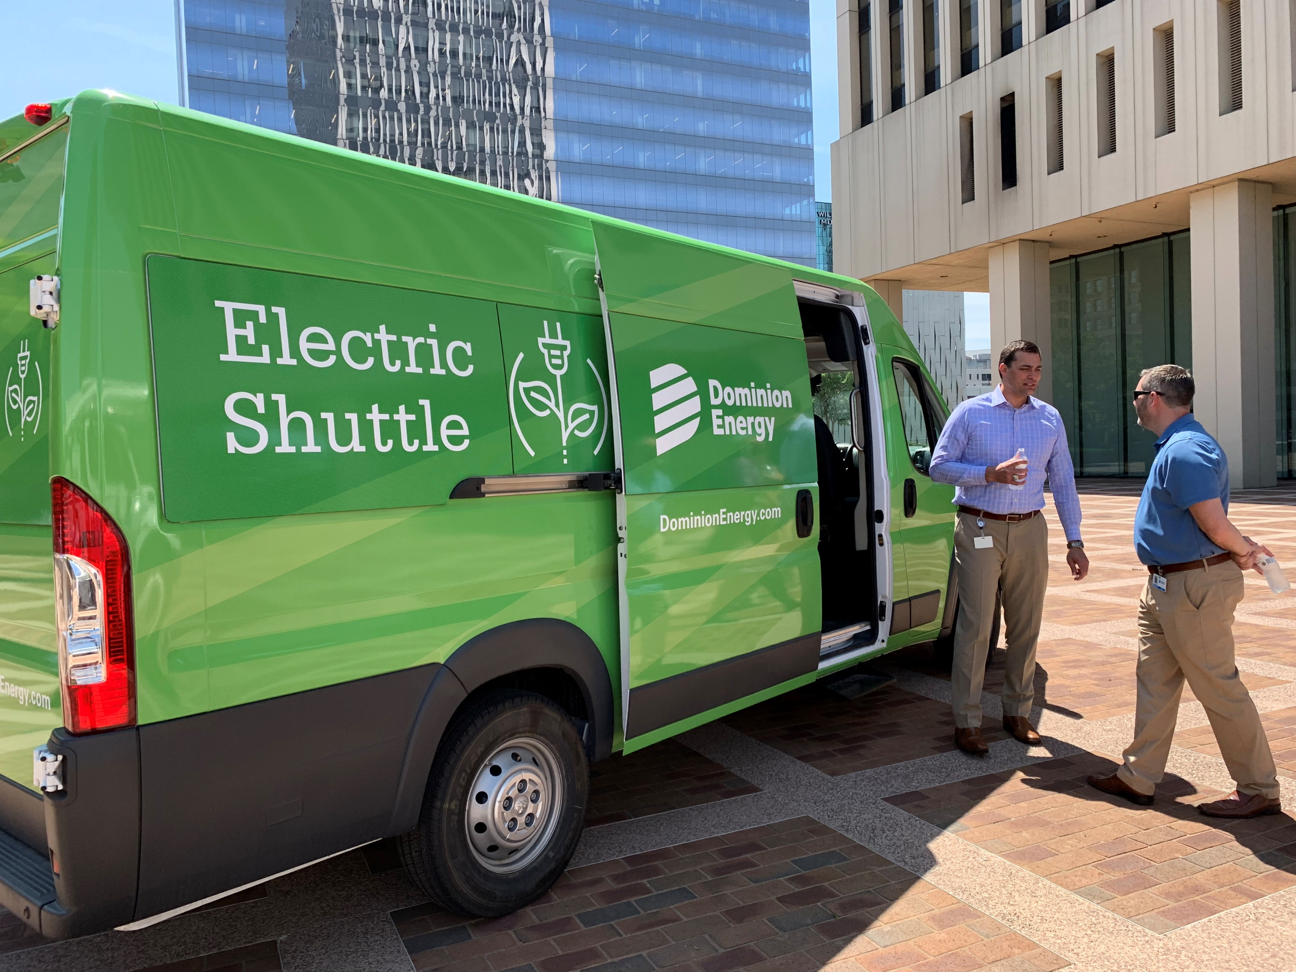
Internal EV Strategies: Leading by Example
Goal of having 25% of light-duty fleet converted to electric or plug-in hybrid electric by 2025
Installing workplace charging stations for employees at a number of offices
Began operating all-electric shuttle between Richmond offices in May 2019
Fairfax County, Virginia and Dominion Energy are partnering on an autonomous electric shuttle pilot

Slide 7
External EV Strategies: Electric School Bus Program
Launched the biggest electric school bus program in the US
Program will reduce emissions, provide cost savings to schools, and enhance grid reliability
Initial phase aims to have 50 buses fully operational in Virginia service territory by year-end 2020
A phase 2 (with state approval) would expand program to 1,000 buses by 2025; a phase 3 would set the goal to have 50% of all diesel bus replacements be electric by 2025 and 100% by 2030
Leverages “vehicle-to-grid” technology; electric bus batteries can be charged and then unloaded when the buses are not needed for transportation

Slide 8
External EV Strategies: Electrification for Transit and Universities
Electric transit buses are cheaper to fuel and maintain than traditional diesel buses
Influx of grant funding for electric transit buses -- Company believes electric transit bus adoption will increase
Electrifying transit buses will extend the benefits of electric transportation to customers that may not physically be able to drive a vehicle of their own, or than may not be financially able to purchase a vehicle
According to the Richmond Times Dispatch, 58% of Lyft rides start or end in low-income areas; rideshare electrification will help ensure the benefits of electric transportation are seen in low income areas

Slide 9
External EV Strategies: Smart Charging Infrastructure Pilot Program
Information and experience gathered from pilot program will further additional investments, pilots, programs, and/or rate designs that will support EV adoption while minimizing the impact of EV charging on the grid
Will consist of rebates for infrastructure and upgrades at EV charging sites (“make-ready”) and smart charging equipment that enables managed charging
Program will offer rebates to multi-family sites, workplace sites, public DCFC sites, and to transit agencies installing infrastructure for electric buses
To be eligible, site host must agree to provide charging data, including:
Time and duration of charging sessions
Energy consumed
Peak demand during charging sessions
Site host responsible for procurement, installation, and ownership of the EV charging stations

Slide 10
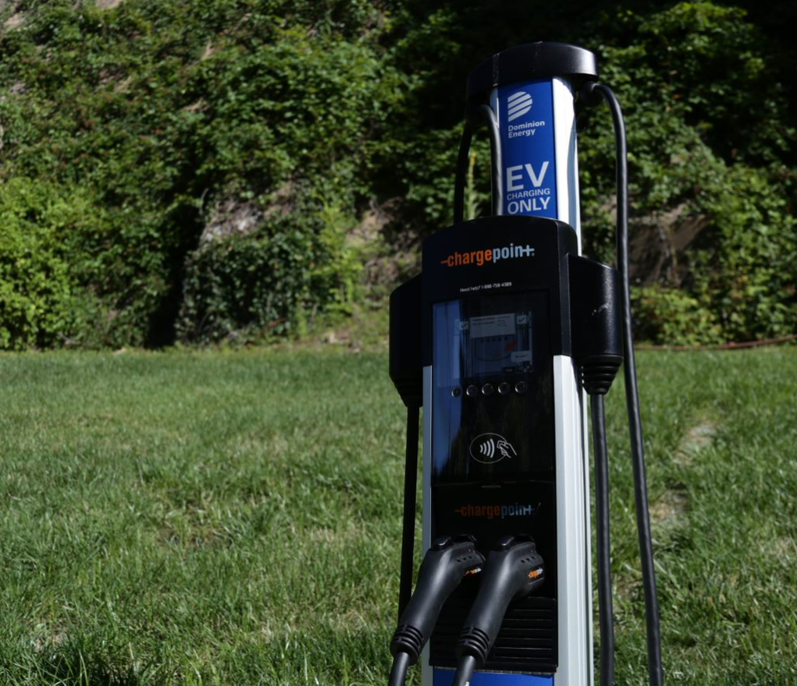
External EV Strategies: Company-owned Rideshare Charging
Company proposes to own up to four charging stations as part of the Smart Charging Pilot Program as part of our ongoing strategy to support electrification in the rideshare market segment
The number of vehicle miles traveled in the rideshare market is growing exponentially and the company doesn’t have the data necessary to understand their charging behavior.
Charging stations will be sited to strategically enable additional electric vehicles to participate in rideshare platforms.
Procurement will be through an RFP process.

Slide 11
External EV Strategies: Smart Charging Infrastructure Pilot Program
Segment | Rebate Amount | Number of Charging Stations
Multi-Family | Up to $4,071 for each dual port Level 2 networked charging station Up to $11,470 for make-ready for each station | Up to 25 charging stations
Workplace | Up to $2,714 for each dual port Level 2 networked charging station Up to $11,140 for make-ready for each station | Up to 400 charging stations
DC Fast Charge | Up to $36,720 for each dual port networked DCFC charging station Up to $73,500 for make-ready for each station | Up to 30 charging stations; each customer must install at least 2 charging stations per site that can charge all EV types; each customer is limited to 4 rebates
Transit | Up to $53,451 for each networked DCFC charging station Up to $73,500 for make-ready for each station | Up to 60 charging stations; each customer is limited to a maximum of 6 rebates

Slide 12
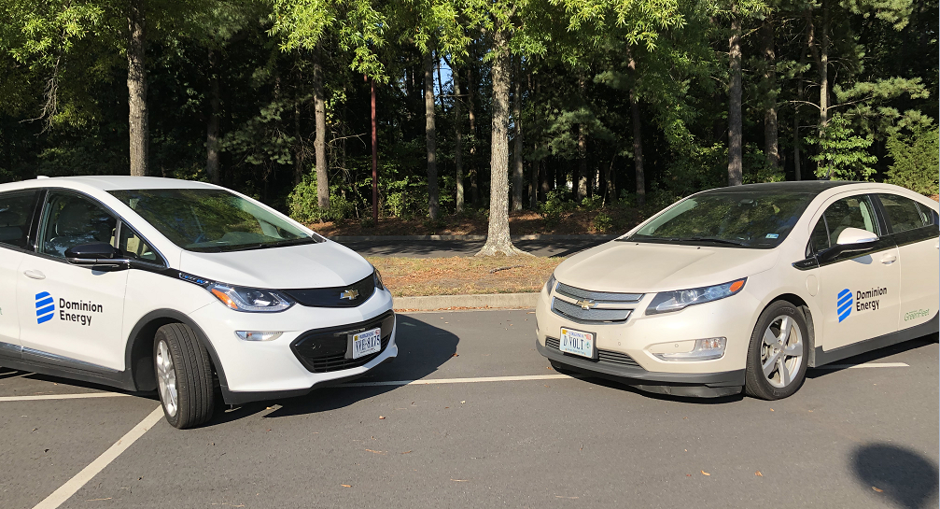
External EV Strategies: Customer Education
Launched innovative online electric vehicle educational tool: dominionenergy.com/EV
Tool includes:
Savings calculator
Carbon reduction information
Charger finder
Commute Calculator
Information EV models and PHEV models
Information about Tax Credits

Slide 13
External EV Strategies: Time-Varying Rates
Company has filed for full AMI deployment in Virginia service territory and is in the process of developing an experimental, voluntary time-varying rate
Time-varying rate structure will allow customers, including EV drivers, to better manage their energy usage
Company is also evaluating Demand Side Management programs designed to encourage efficient EV charging and shifting of EV charging load to off-peak periods.
Solicited input in most recent Demand Side Management RFP. Reviewing the results in advance of next Demand Side Management filing.

